Slide 1


Web Application Testing

Slide 2
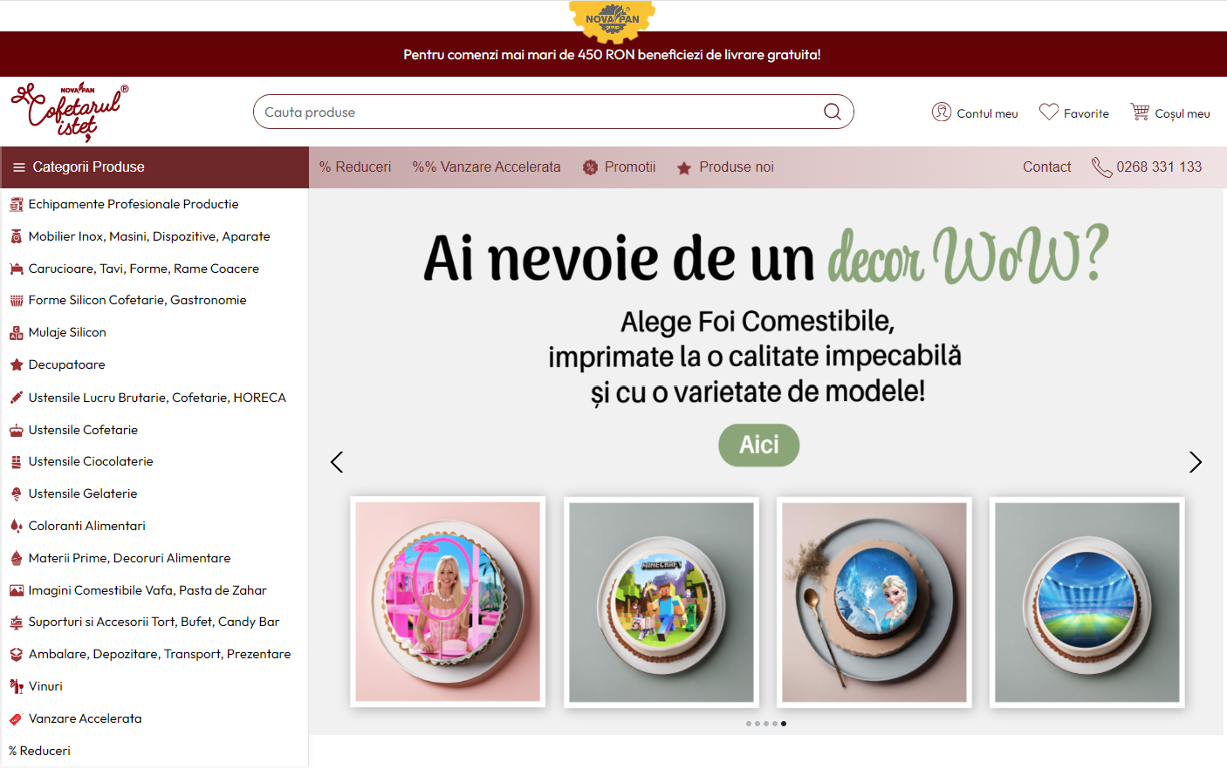
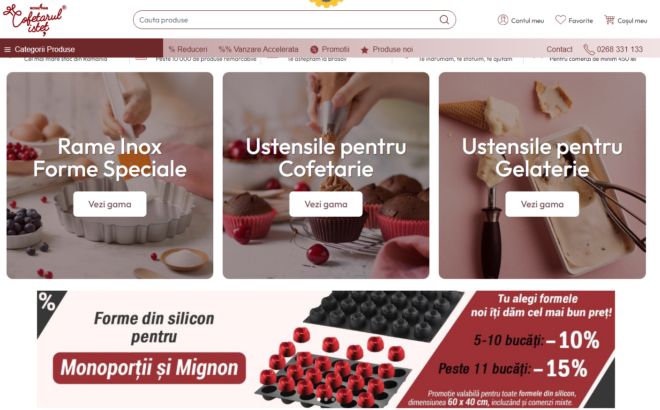
Application Description
Brașov based Romanian Brand
Online shopping site supplying:
Professional bakery equipment
Bakery Furniture & Tools
Bakery, pastry, chocolate & gelato ingredients
Eatable decorations & food colorants
Wines
Packaging & others

Slide 3

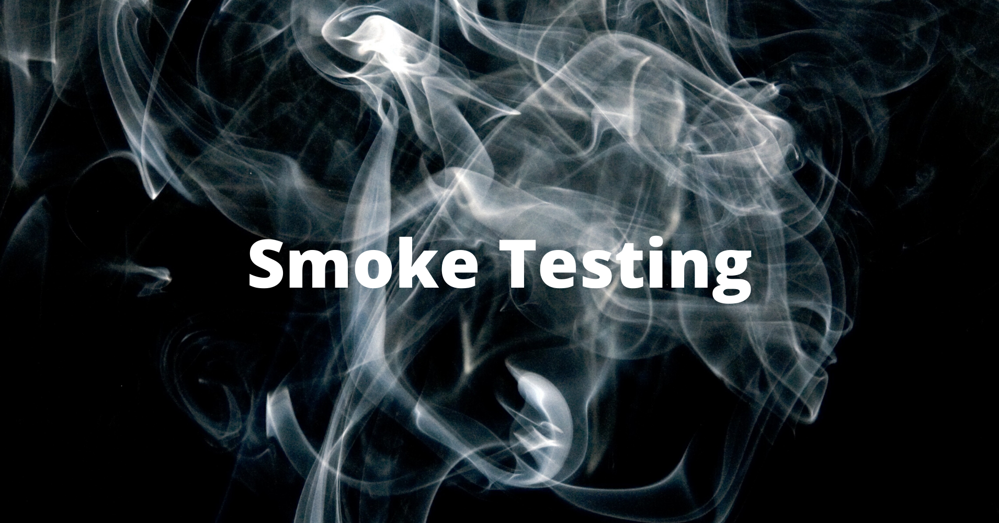
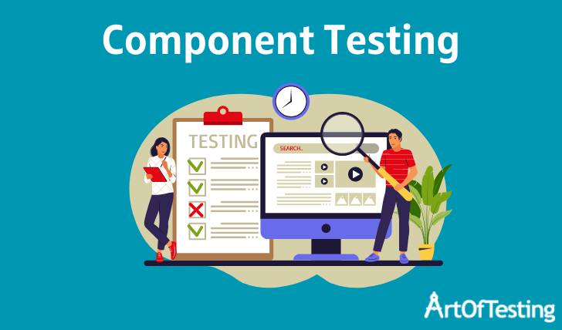



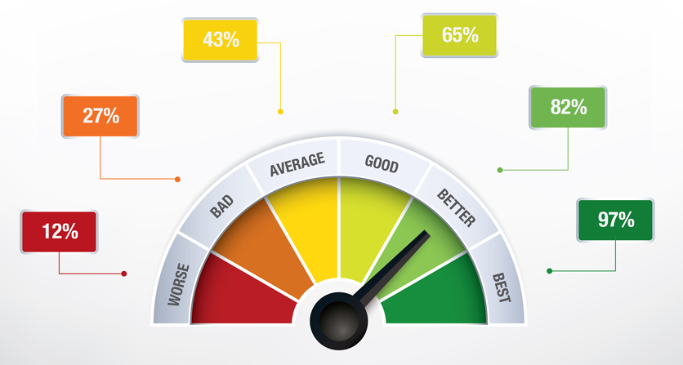
Testing approach
Exploratory testing for main functionalities
Smoke test for important features
Component testing
Positive testing
Negative testing
Compatibility testing
Security testing
Performance testing

Slide 4







Tools Used

Slide 5
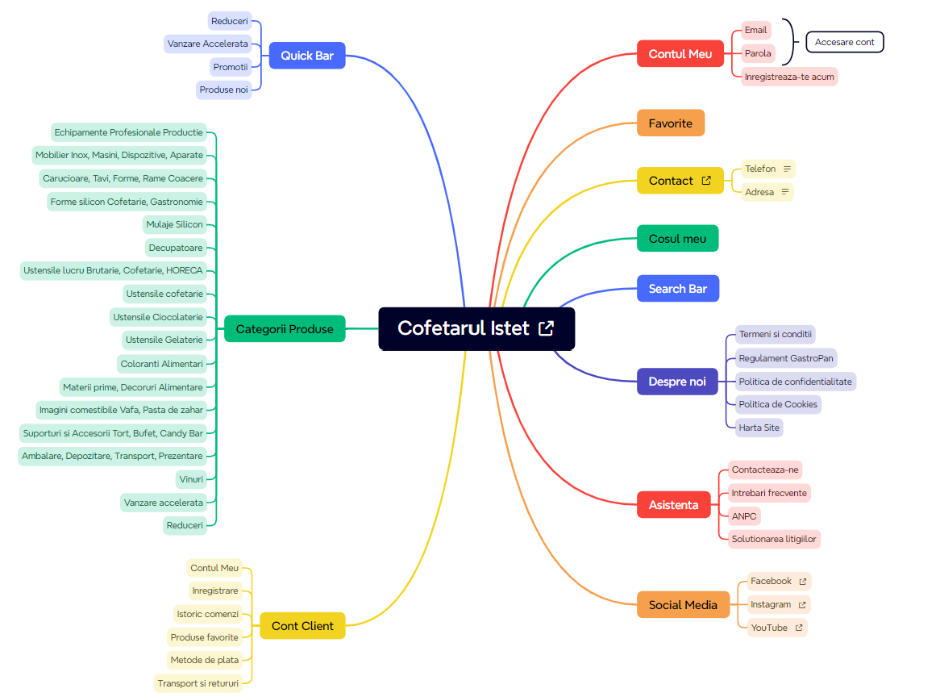

Slide 8
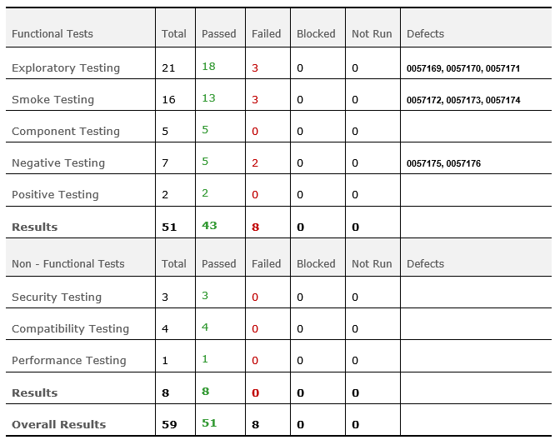
Test case results

Slide 9



The total number of tests conducted was 59, out of which 51 tests (86.4%) passed and the remaining 8 (13.6%) failed. No blocked tests were found
Conclusions
Functional Tests were divided into Exploratory (36%), Smoke (27%), Component (8%), Negative (12%) and Positive (3%) while the Non-Functional Tests were divided into Security (5%), Compatibility (7%) and Performance (2%)
Out of 8 bugs, 50% have normal severity and 50% with major severity
As there were no requirements and specifications for this project, the goal was to cover the website content as much as possible with relevant tests and the approach was to divide the testing in both Functional Tests and Non-Functional Tests
There are 3 defects categorized as improvements, 3 categorized as bugs and 2 categorized as feature. I will surely pass this information to my friend so that updates to the site can be made if he chooses so, along with other UI improvements noticed during tests but not covered by Test Cases

Slide 10
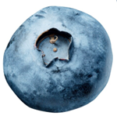

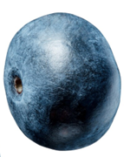
Lessons learned
Reach out, connect with new people and learn something new
Learn to listen and understand the end users perspective, then you’ll know what to test
Don’t be afraid to ask questions, this is what exploratory testing means
Automation testing does not replace manual testing
Quality is everybody’s responsibility, everywhere, anytime, all the time

